Slide 1

Bottlenecks and Beef Prices
Workshop on Food Prices and Forecasting
July 31, 2024
Tais Menezes, CSU DARE
Jude Bayham, CSU DARE
Matthew MacLachlan, Cornell
Samantha Padilla, USDA ERS
Amanda Countryman, CSU DARE
#58-4000-2-0106

Slide 2

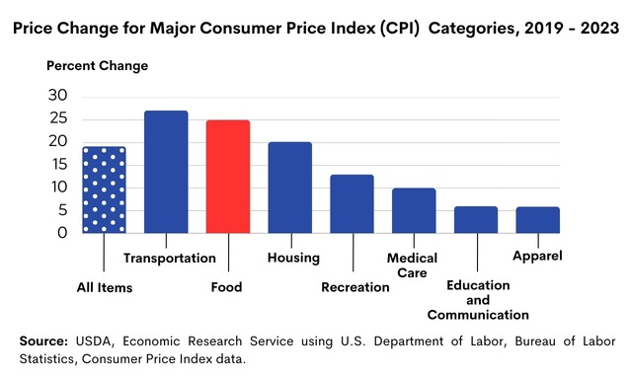
Consumers don't like rapidly rising prices
Transportation, Food and Housing have led the CPI
Understand why prices are rising
How long will the pain last?

Slide 3
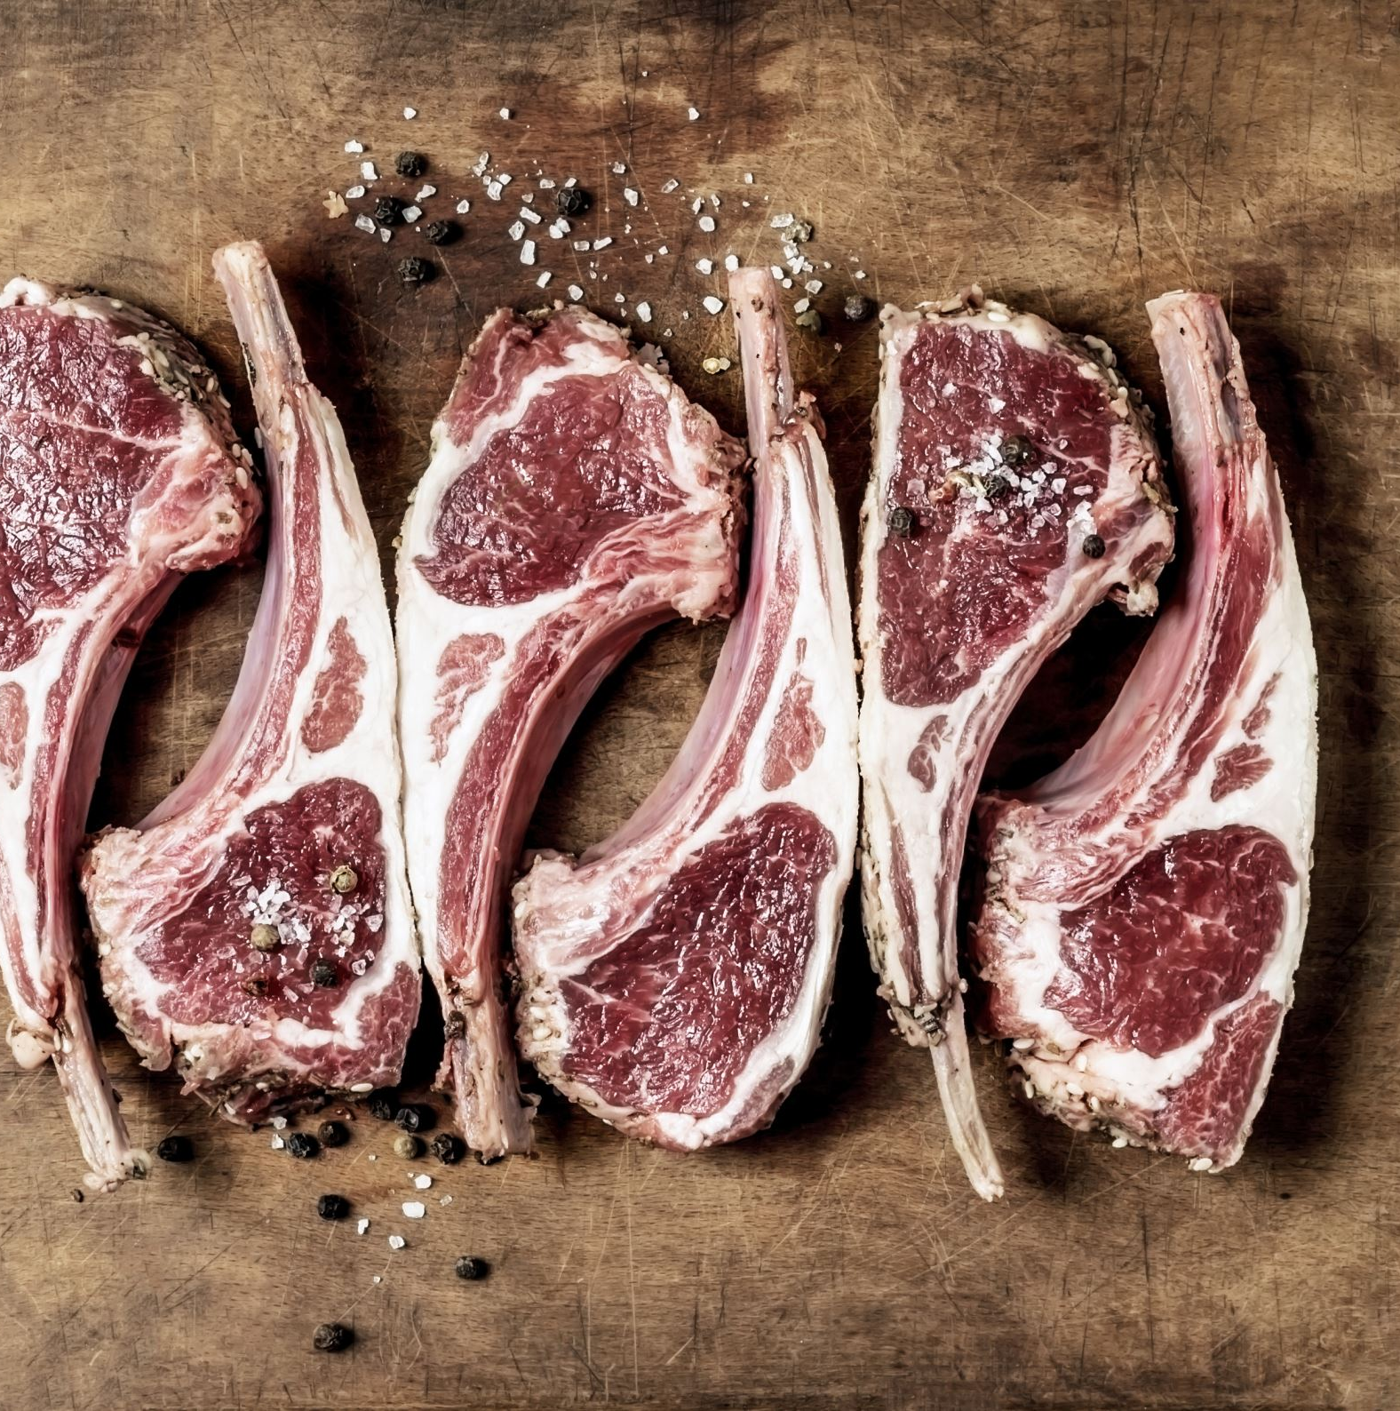
Research Question:
How long do shocks persist in US wholesale beef prices?
Notes:
Why beef? It was one of the quickest rising price series.

Slide 4
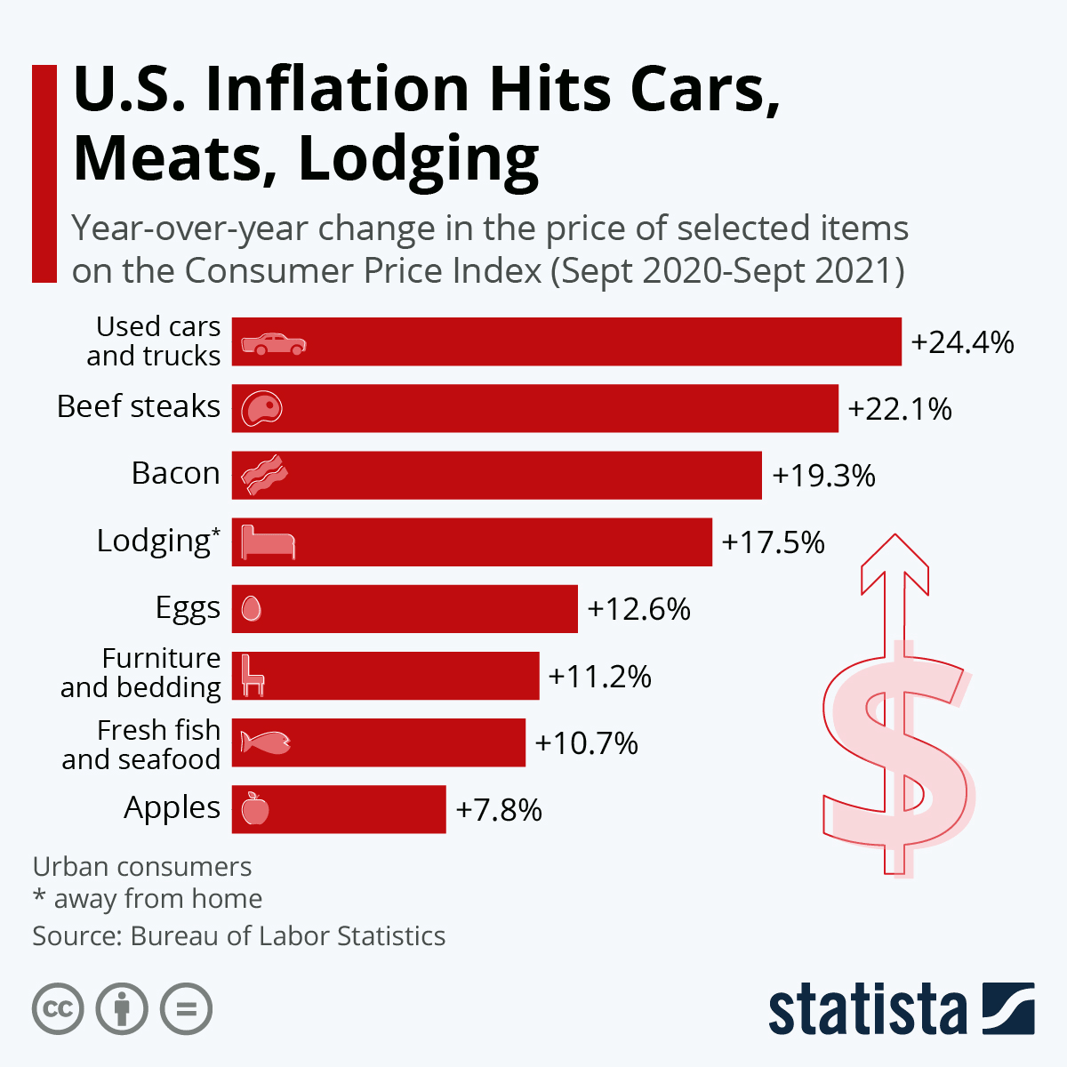
Why beef?
Notes:
Why beef? It was one of the quickest rising price series.

Slide 5
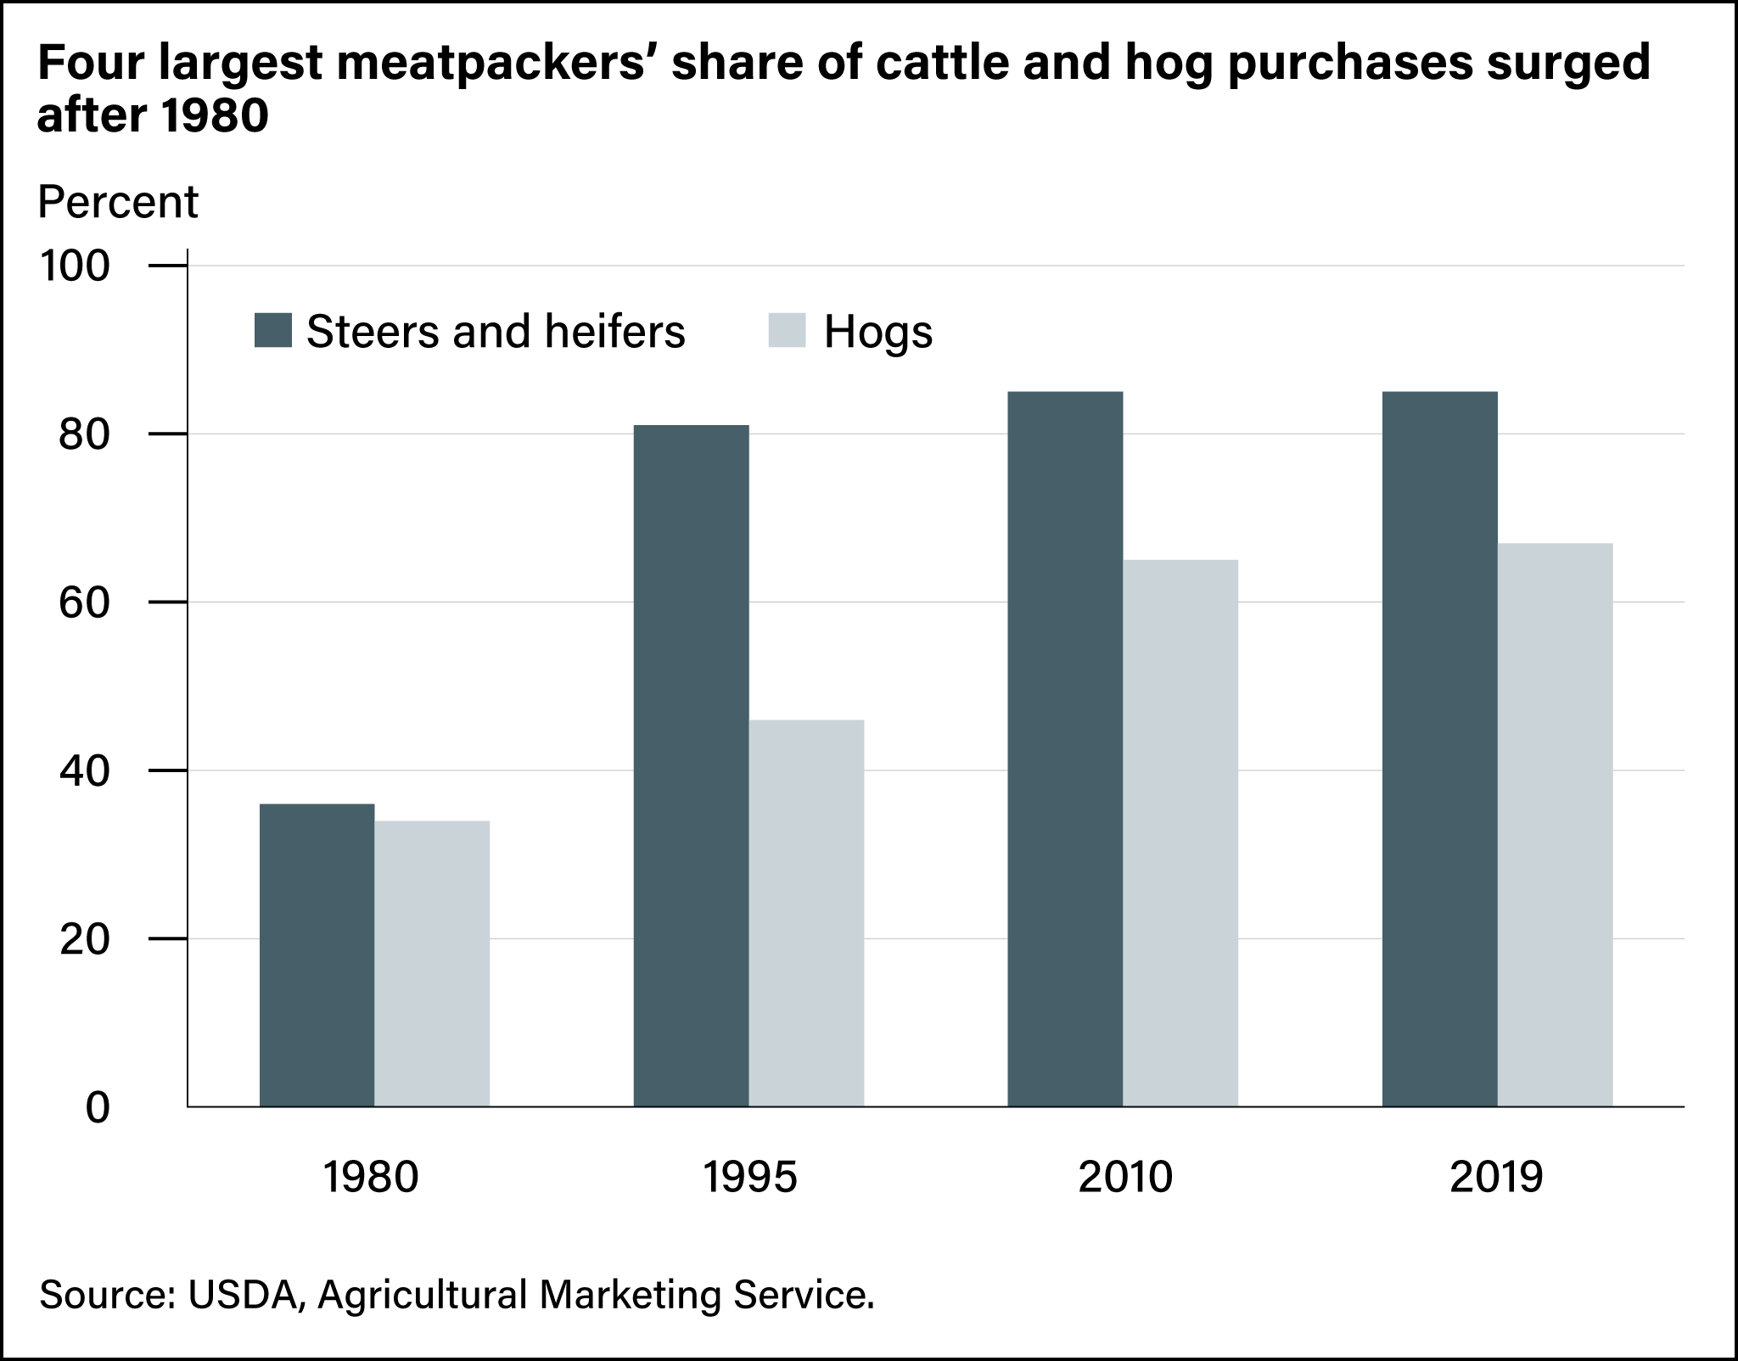
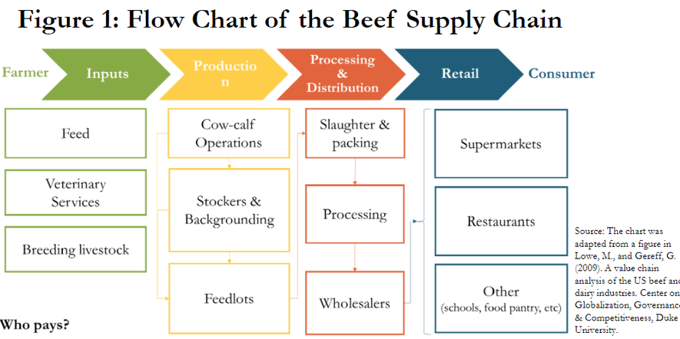
We focus on processing because of the consolidation of packers

Slide 6
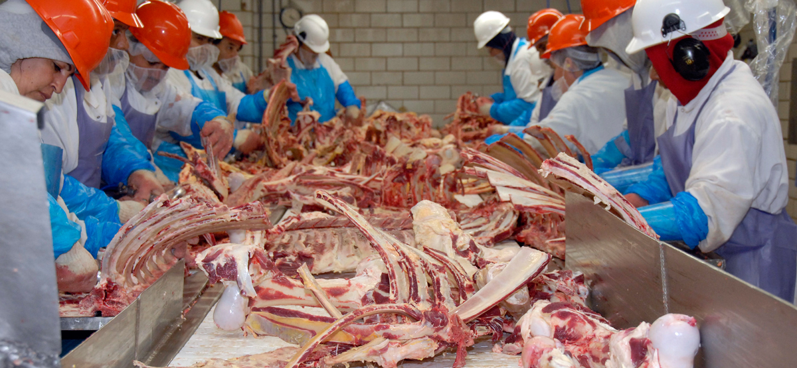
Safety practices and outbreaks led to closures and reduced capacity

Slide 7
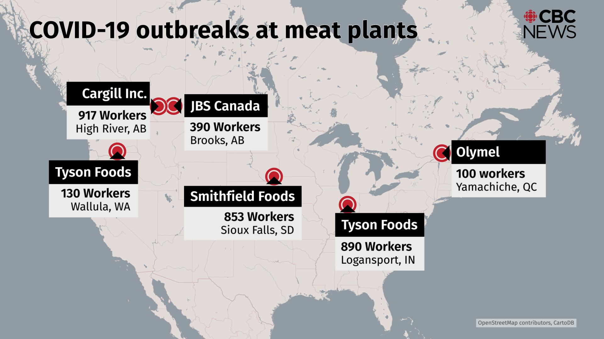

Slide 8
Approach and Contribution
Compile daily US wholesale beef price data from USDA AMS reports (National Daily Cattle Beef Summary Report)
Estimate impulse response functions using local projections method (Jorda, 2005)
Find that the initial COVID-19 shock lasted ~45 days

Slide 9
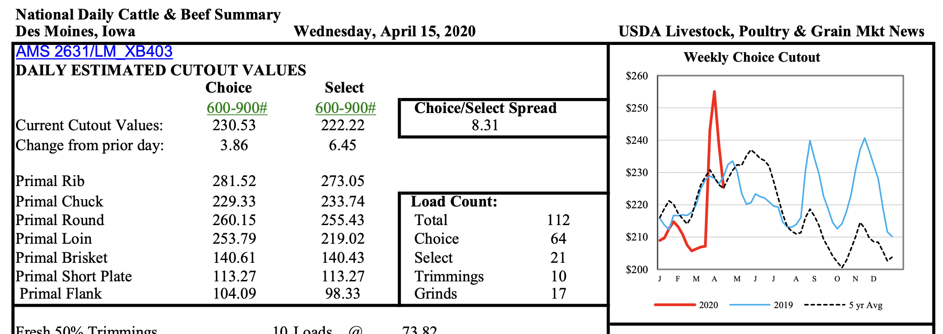
Choice and select ($/cwt)

Slide 10
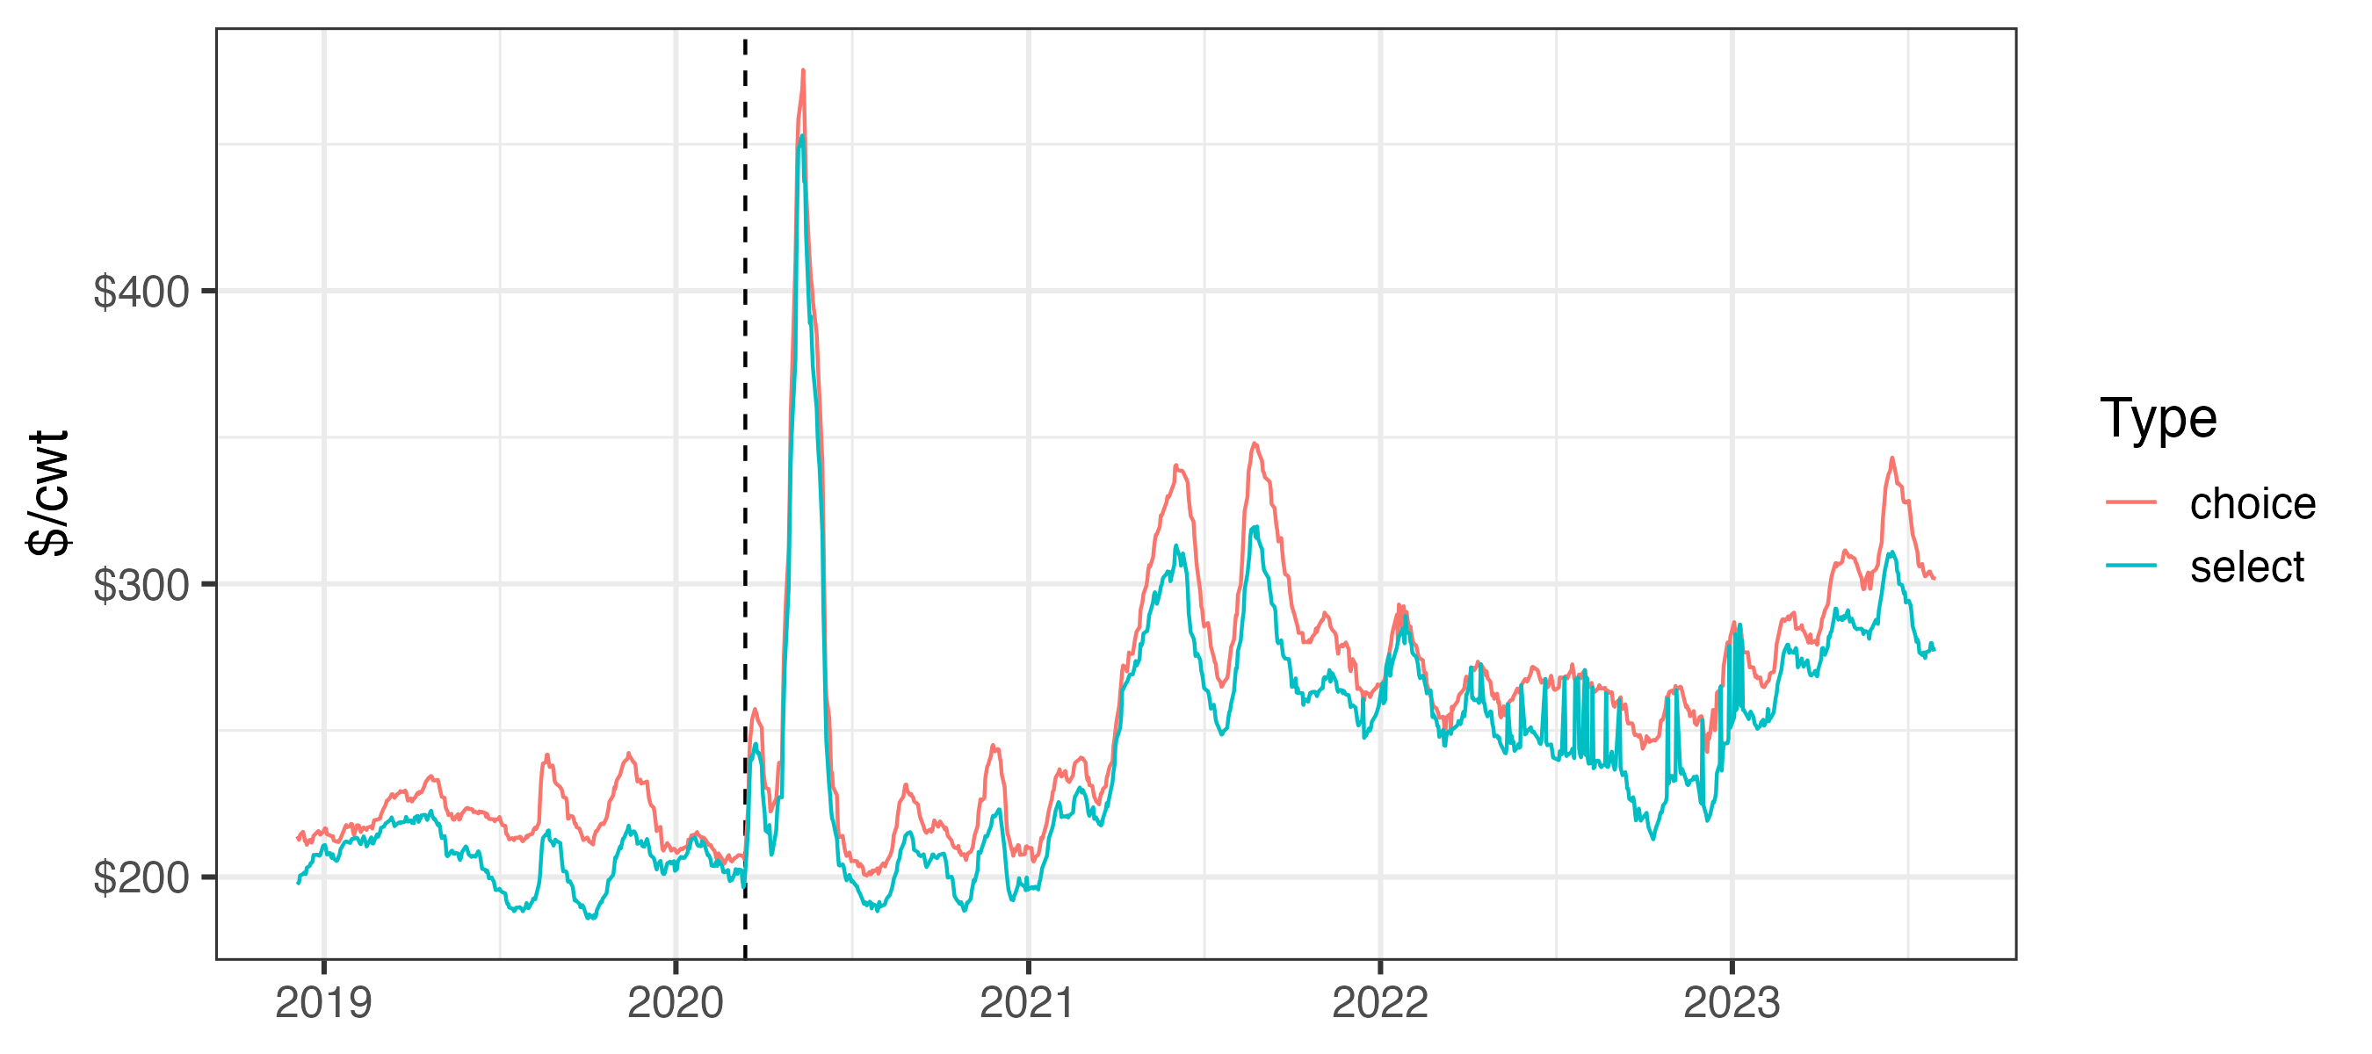
Wholesale prices fluctuate but spiked in March 2020
Mar 13:
public health emergency

Slide 11
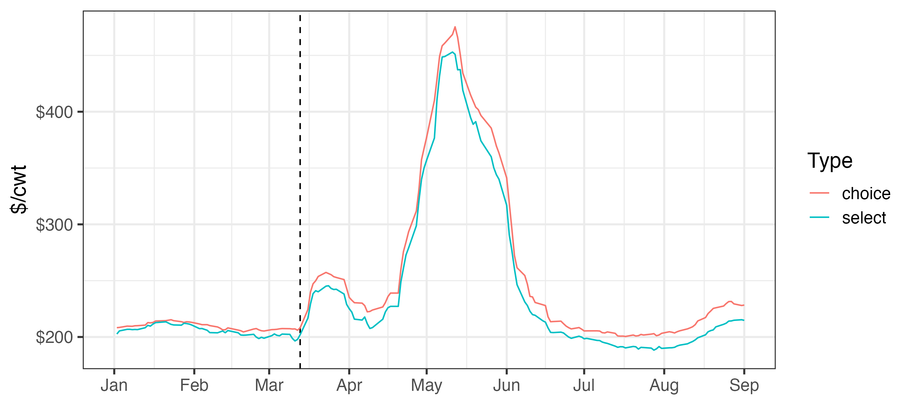
Wholesale prices fluctuate but spiked in March 2020
Mar 13:
public health emergency

Slide 12
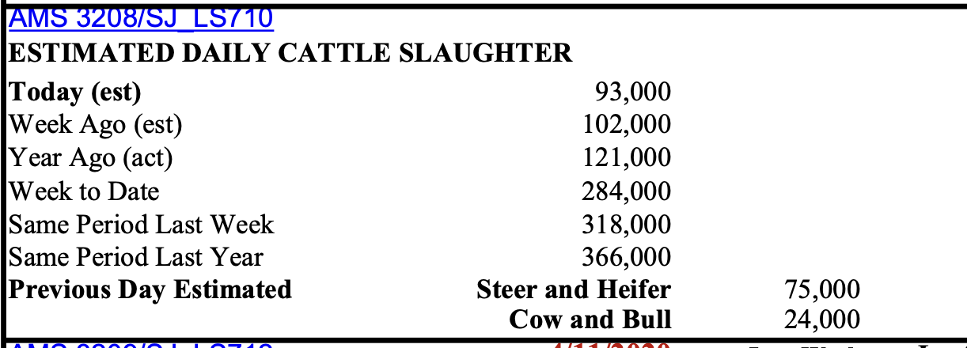
Daily slaughter volumes (head)

Slide 13
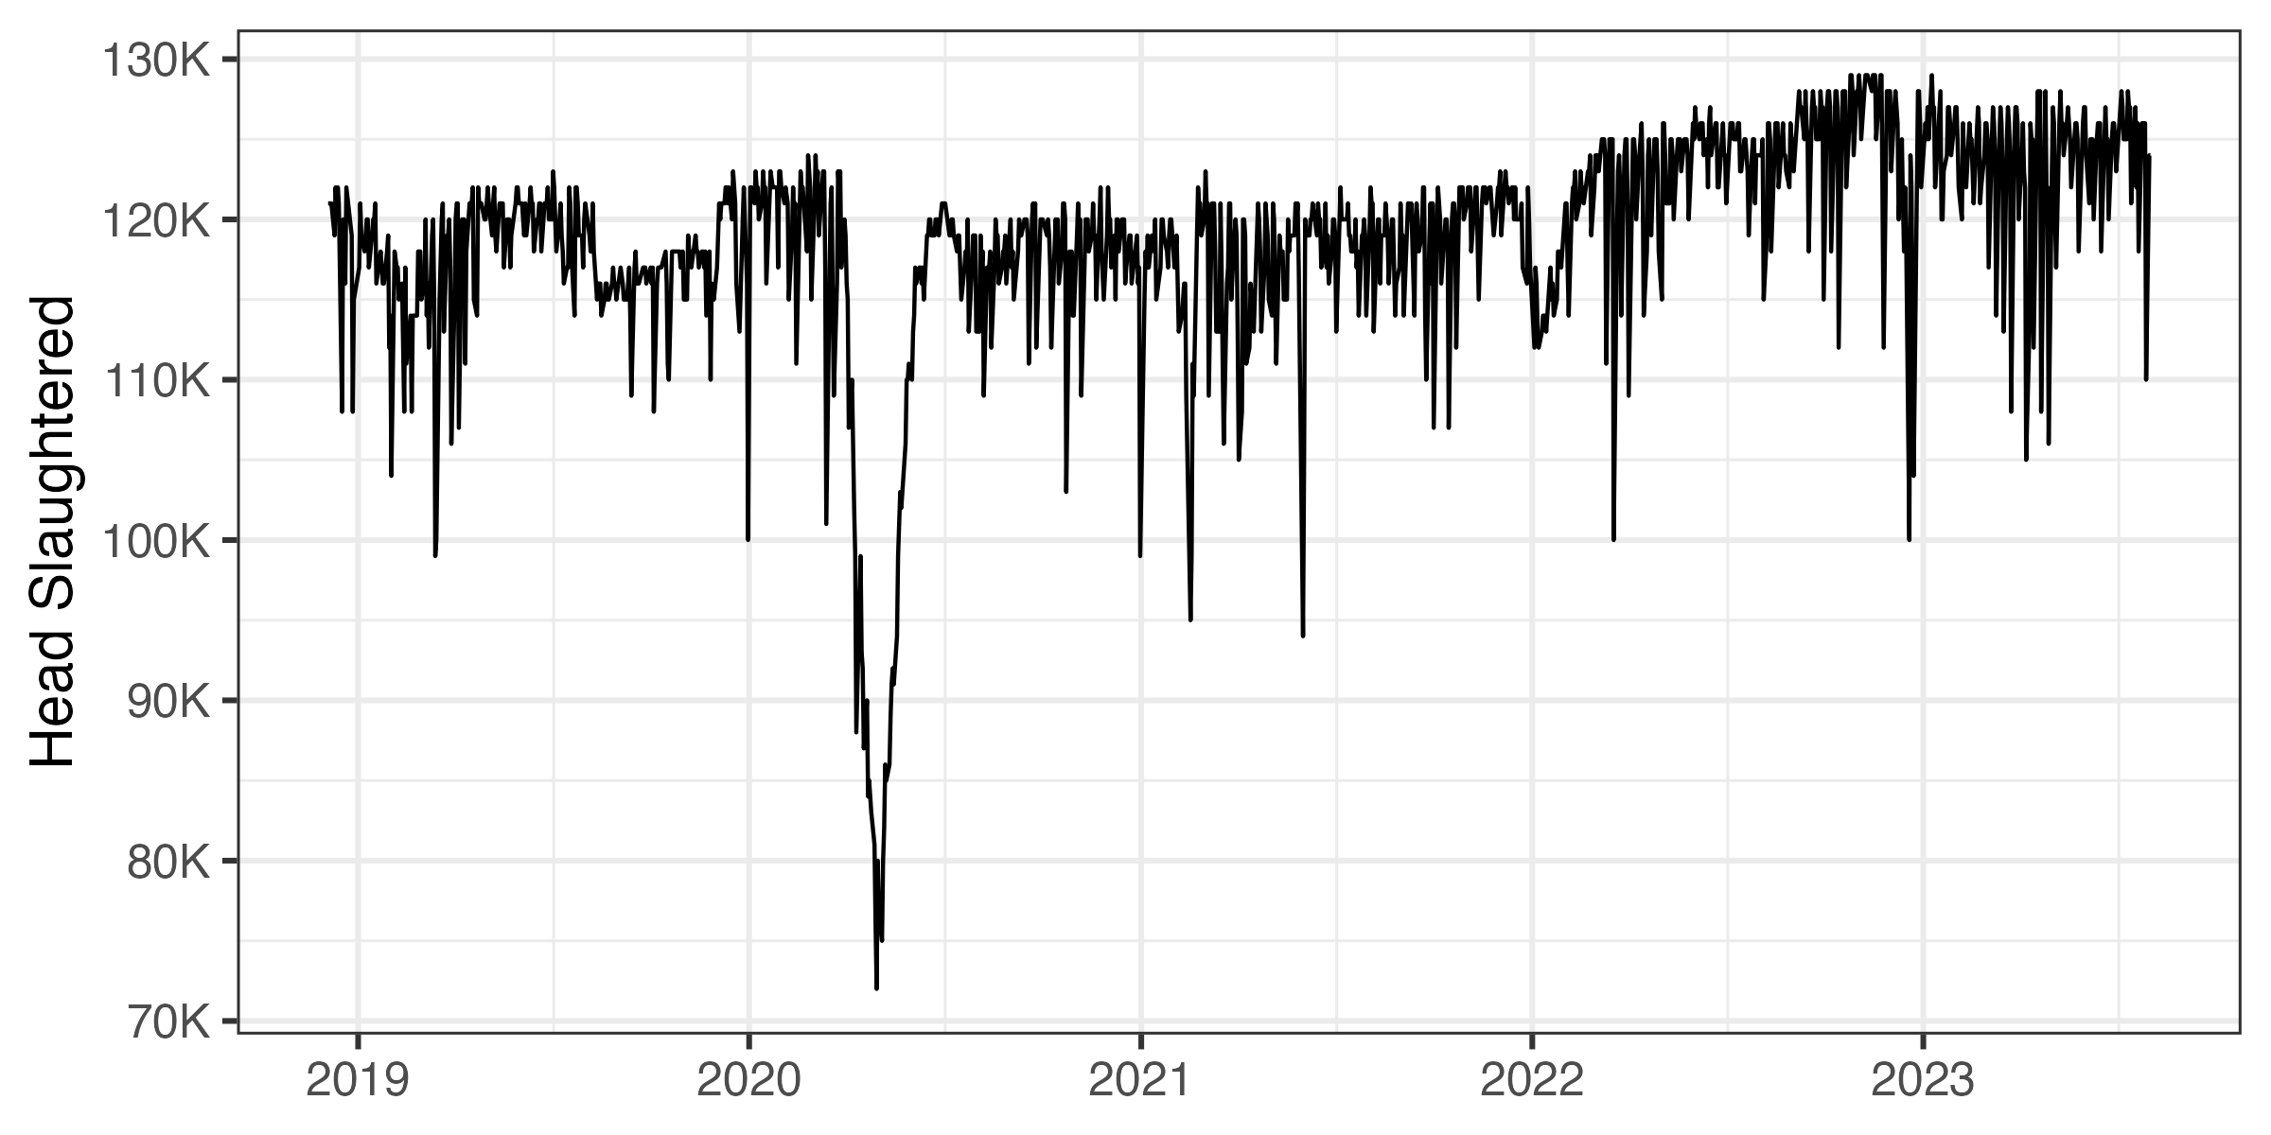
Daily slaughter volumes over time

Slide 14
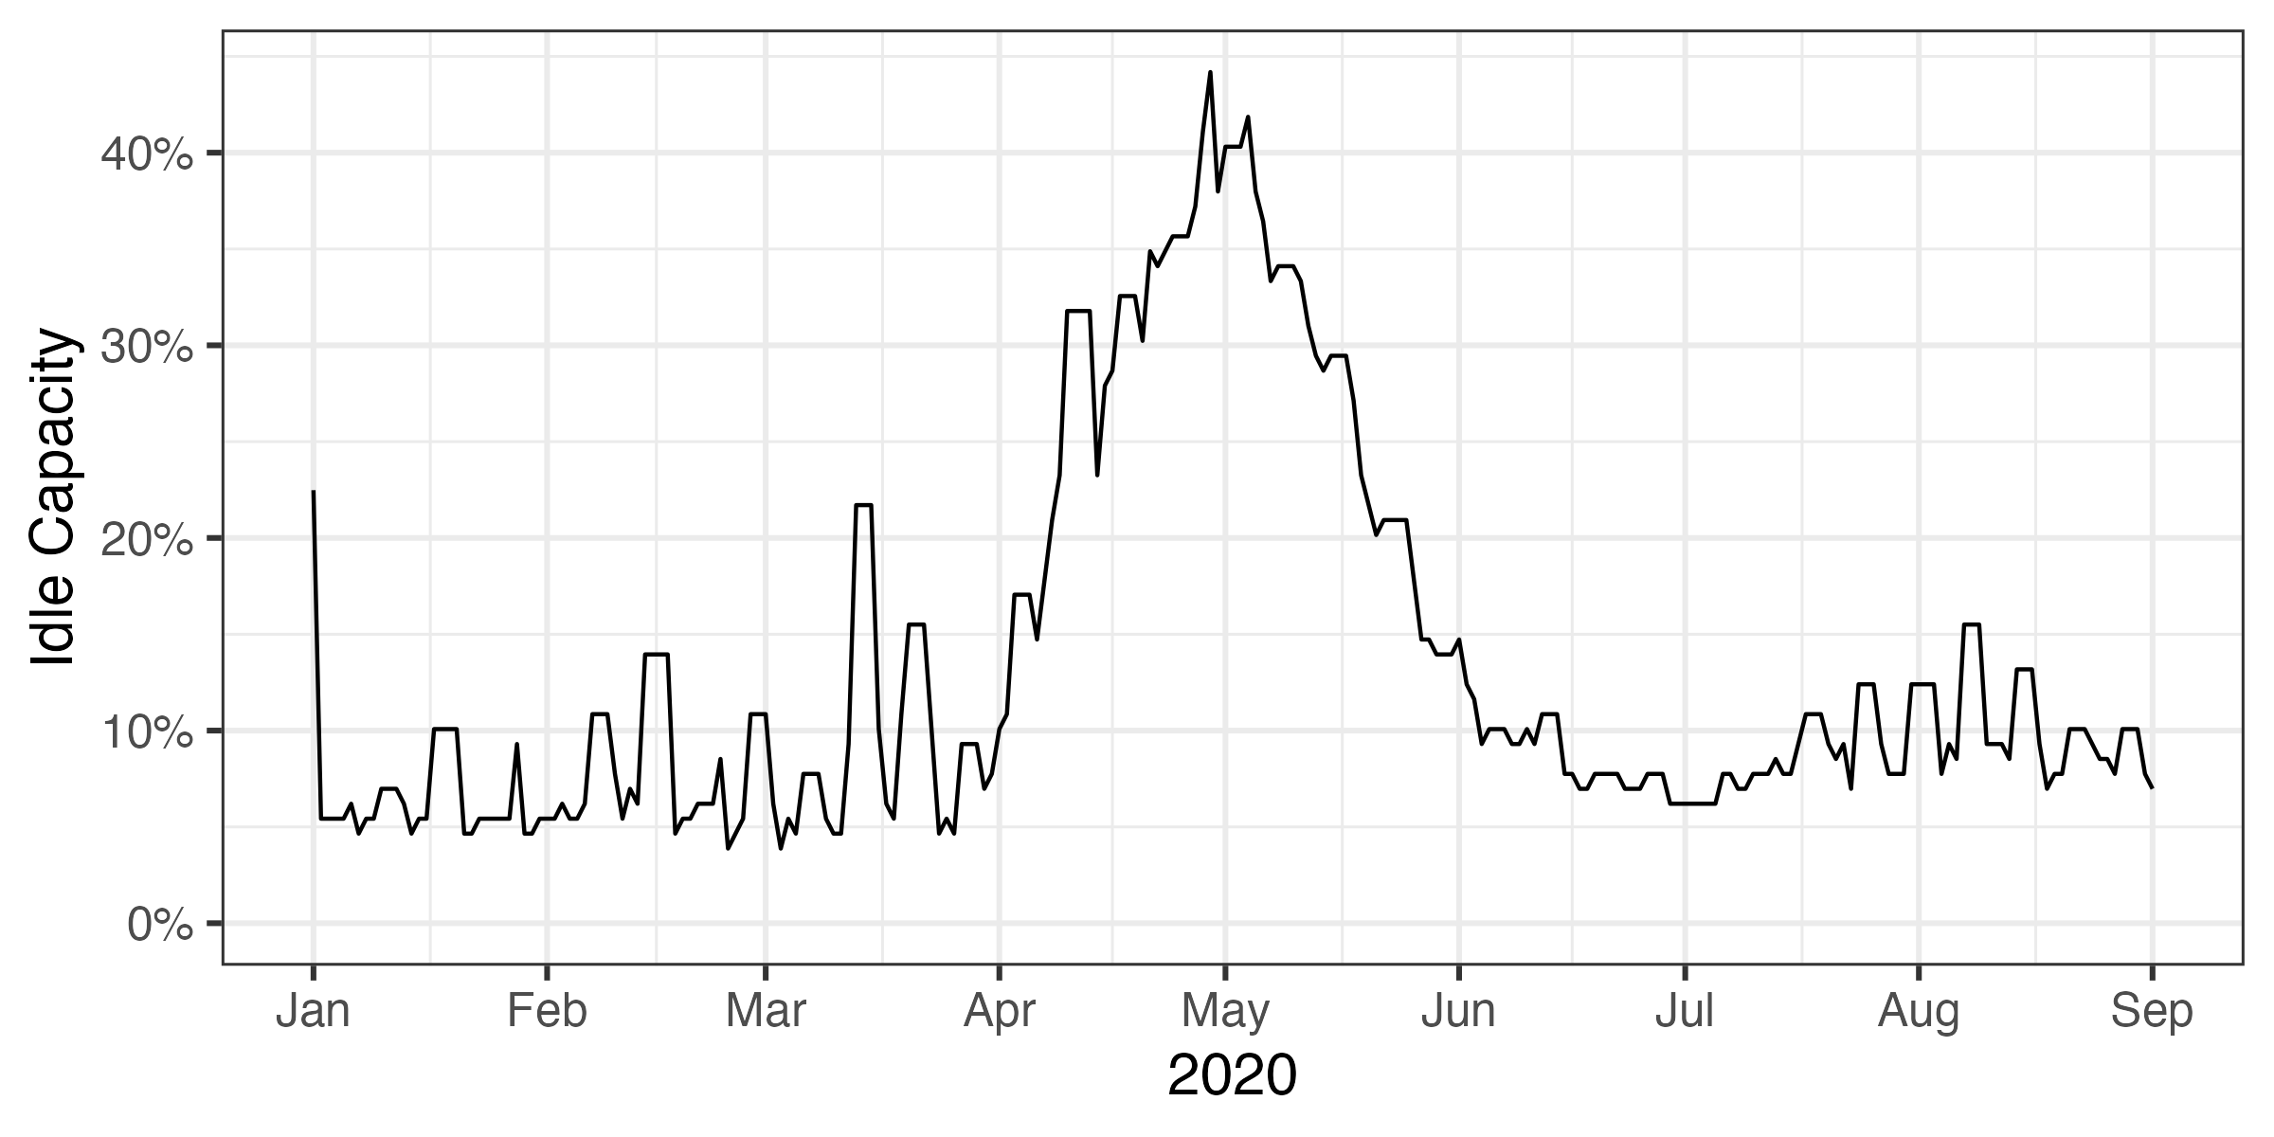
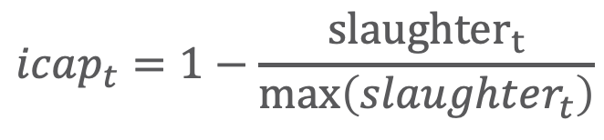
Constructed idle capacity from slaughter
$$icap_{t}=1−\frac{{slaughter}_{t}}{\max\left(slaughter_{t}\right)}$$
Notes:
Idle capacity = 1- today/max(today,year_ago)

Slide 15
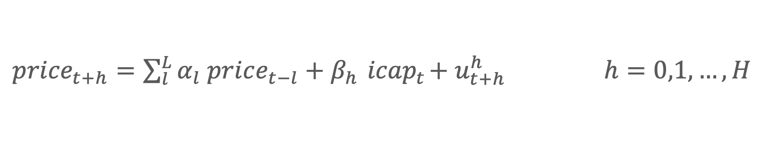
Data Processing & Local Projections
Fill NAs with previous day when data not reported
Use Seasonal and Trend decomposition using Loess to remove seasonality and trend from US wholesale beef price. Result is stationary series.
Estimate H models:
${price}_{t+h}=\sum_{l}^{L}{α_{l} price_{t−l}}+β_{h}{ icap}_{t}+u_{t+h}^{h} h=0,1,…,H$
Lag length is determined by AIC
Newey-West standard errors

Slide 16
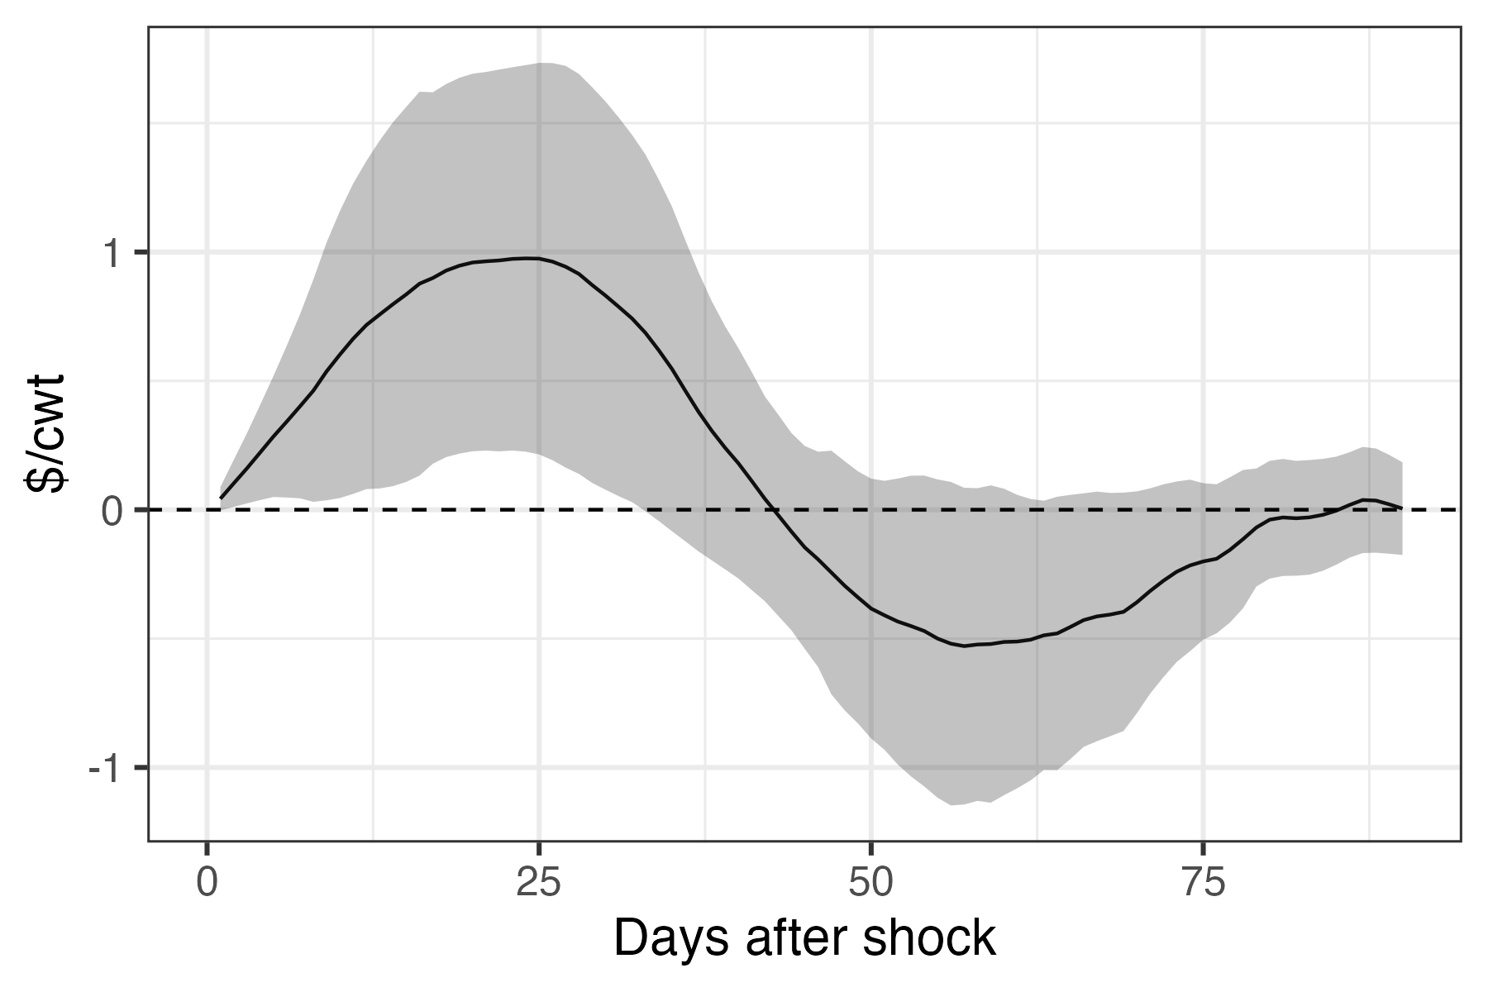
Capacity shock impacts US wholesale beef prices for about 45 days 1% increase in idle capacity increases price by $1/cwt at peak (~25 days after shock) Or $25/cwt per 1% increase in idle capacity Idle capacity was 45% on April 28
Impulse Response Functions
(effect of 1% increase in idle capacity)

Slide 17
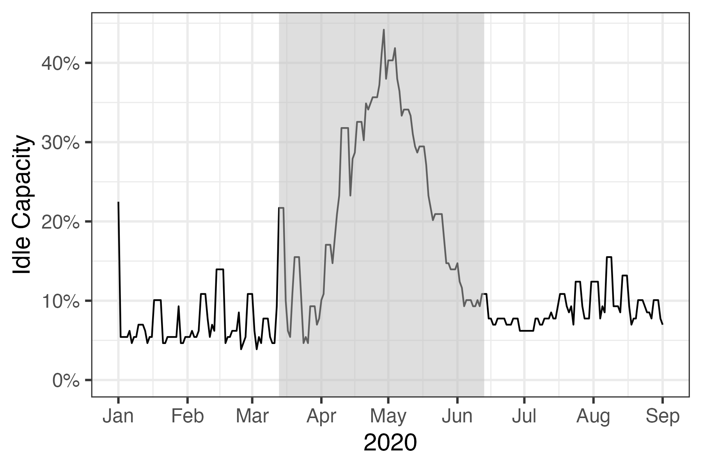
Applying the $25/cwt to the idle capacity from Mar 13 to June 13, the total effect is $513/cwt
Impulse Response Functions
(effect of 1% increase in idle capacity)
Idle capacity in 2020

Slide 18
Conclusions and next steps
Acute shocks to processing/packing reduce supply and cause temporary price increases
COVID-19 led to labor shortages and plant closures, impacting prices for ~45 days by $25/cwt for each 1% increase in idle capacity
Next steps: use local projections model to study impacts of drought

Slide 19
Jude Bayham​
Email: jbayham@colostate.edu​
Web: https://sites.google.com/site/judebayham/home​
GitHub: https://github.com/jbayham​

Slide 20
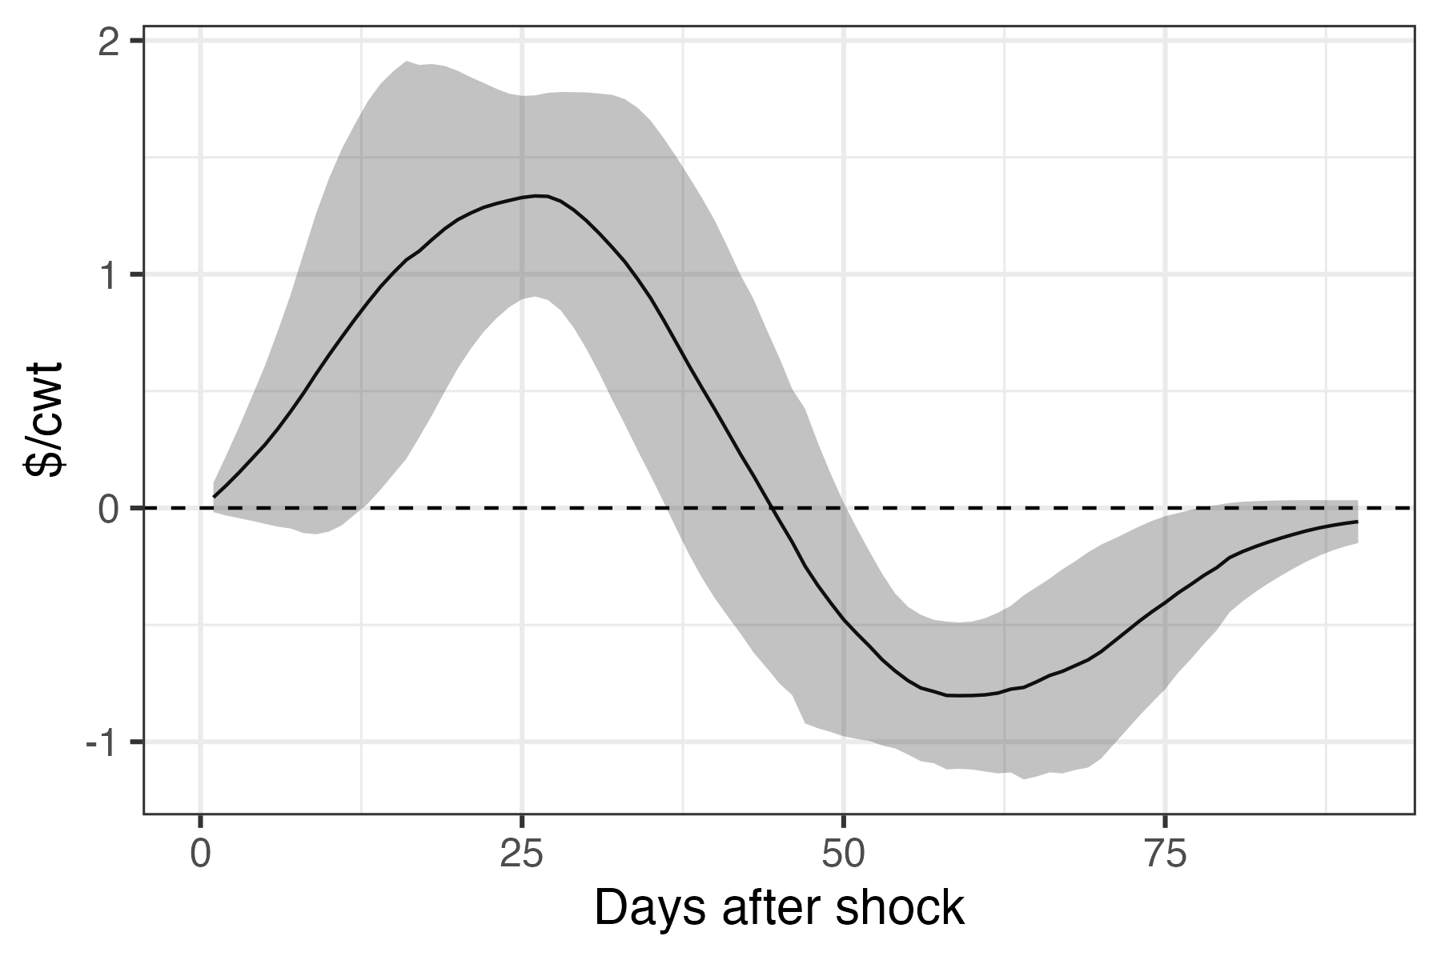
Impulse Response Functions
(effect of 1% increase in idle capacity: Mar - Jun)

